Slide 1

Importance of modeling H-atoms
Jacob Overgaard
Senior Scientist
Department of Chemistry
Aarhus University
jacobo@chem.au.dk

Slide 2


Slide 3
Outline
Why at all care about H-atoms in CD studies?
Hydrogen bonds characteristics
Ways to get info on H parameters
Combining data from different experiments
Properties of hydrogen bonds
Outlook for exercise #3

Slide 4

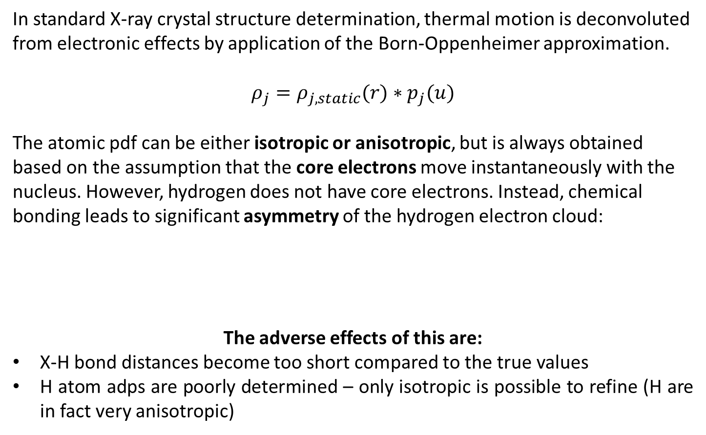
Hydrogen and X-rays
In standard X-ray crystal structure determination, thermal motion is deconvoluted from electronic effects by application of the Born-Oppenheimer approximation.
$$ρ_{j}=ρ_{j,static}(r)∗p_{j}(u)$$
The atomic pdf can be either isotropic or anisotropic, but is always obtained based on the assumption that the core electrons move instantaneously with the nucleus. However, hydrogen does not have core electrons. Instead, chemical bonding leads to significant asymmetry of the hydrogen electron cloud:
The adverse effects of this are:
X-H bond distances become too short compared to the true values
H atom adps are poorly determined – only isotropic is possible to refine (H are in fact very anisotropic)
Real H pos
Apparent H pos
Notes:
To understand the problems that face us with hydrogen atoms, we have to remember that X-rays are scattered by the electrons!
The normal assumption is that we can derive the atomic positions from the centroids of the electronic distributions. The B-O approx says that the electrons follow the nuclei instantaneously and hence the centroids of the core electrons is identical to the nuclear position. However, hydrogen does not have core electrons, so the atomic position is not easily derived – in fact, what happens is that the position is artificially moved towards the atom to which it is bound. (BOND LENGTH SHORTENING).
When the position is not accurately described, the thermal motion is also not so easy to refine. The normal BO allows us to model the ADP, or the DW factor, as the FT of the atomic pdf. However, assuming a spherical core IAM density is wrong and so the ADPs cannot be modeled accurately. However, if we convolute the pdf with an aspherical hydrogen pdf then the DW may be more accurately recovered.
The DW factor is the FT of the probability density function. The scattering factor of the thermally smeared density is the sf for the static density times the DW. This may be isotropic or anisotropic.

Slide 5
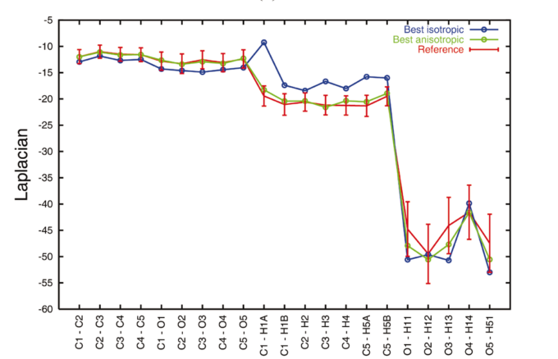
Hydrogen and X-rays
In fact, if H-atoms are not properly paid attention to, the whole resulting electron density model may be affected.
From Madsen et al., Acta Cryst, A60, 2004, 550
It is particularly damaging and critical when the subject of the study is dependent on an accurate determination of hydrogen parameters, which is the case for
HYDROGEN BONDS

Slide 6
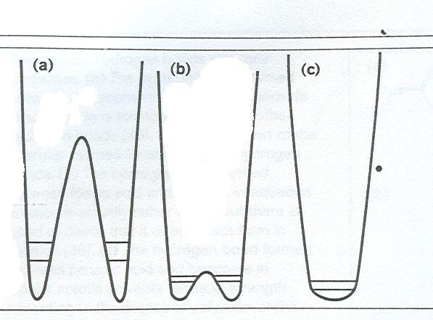
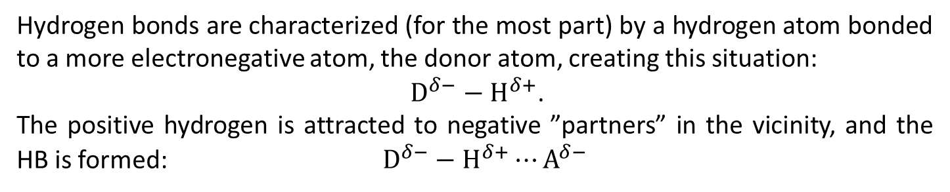
Hydrogen bonding
Hydrogen bonds are characterized (for the most part) by a hydrogen atom bonded to a more electronegative atom, the donor atom, creating this situation:
${\text{D}}^{δ−}−{\text{H}}^{δ+}$.
The positive hydrogen is attracted to negative ”partners” in the vicinity, and the HB is formed: ${\text{D}}^{δ−}−{\text{H}}^{δ+}⋯{\text{A}}^{δ−}$
Potential energy curves
Normal and weak HB with double well potential.
d(O---O) > 2.65 Å
c) Very short and strong with no energy barrier
d(O---O) < 2.5 Å
b) Stronger, shorter with a low energy barrier
d(O---O) > 2.5 Å

Slide 7
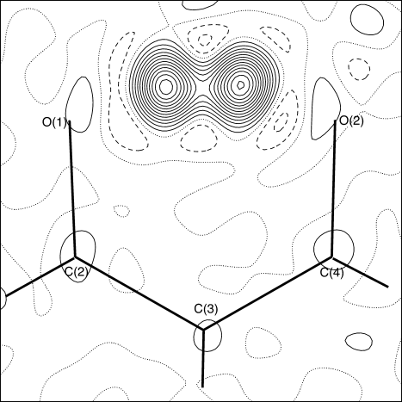
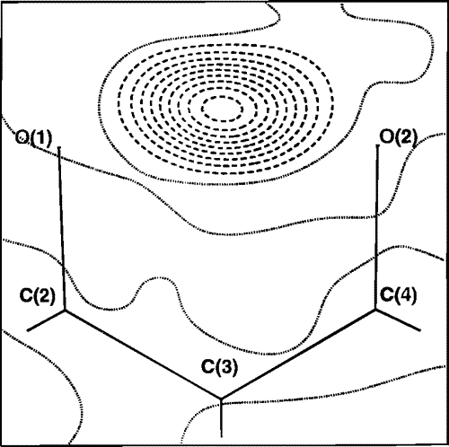
HB type?
One interesting way to discover which of the previous types a particular HB belongs to is to remove the H-atom and calculate the Fourier coefficients from such a model. One example shown here is from neutron data, showing neutron data for benzoylacetone, hydrogenated and deuterated – which is which?

Slide 8
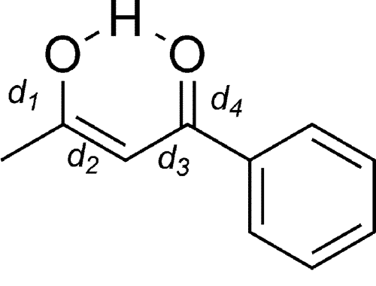
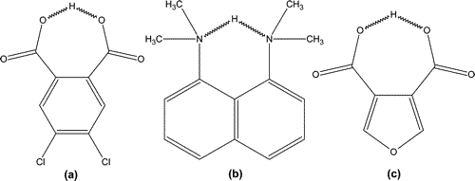
Hydrogen bonding
Classification schemes by Gilli et al.
RAHB
(-)CAHB
(+)CAHB
[O---H---O]⁻
[O---H---O]⁺
-
+
From Gilli et al., JACS, 2004, 126, 3845 and references therein.

Slide 9
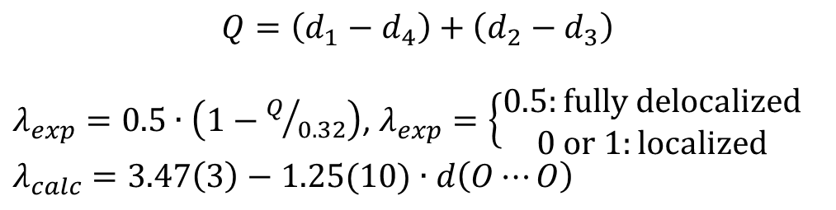
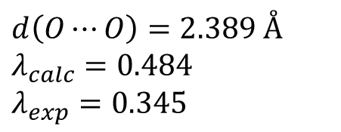
Hydrogen bonding
RAHB
$$Q=\left(d_{1}−d_{4}\right)+\left(d_{2}−d_{3}\right)$$
$λ_{exp}=0.5∙\left(1−Q/{0.32}\right)$, $λ_{exp}=\left\{\begin{aligned}0.5:\text{fully} \text{delocalized} \\ 0 \text{or} 1:\text{localized}\end{aligned}\right.$
$$λ_{calc}=3.47\left(3\right)−1.25(10)∙d\left(O⋯O\right)$$
λ-test: Compare λ_{exp} with λ_{calc}
However, examples clearly contradicting this system exist.
$$d\left(O⋯O\right)=2.389 Å$$
$$λ_{calc}=0.484$$
$$λ_{exp}=0.345$$

Slide 10
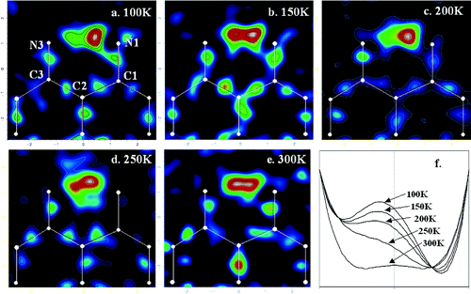
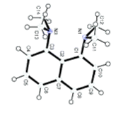
Still a lot to learn from X-ray data
Accurate multi-temperature X-ray studies combined with difference Fourier methods may illustrate the proton movement, i.e. reveal details of the potential energy surface

Slide 11
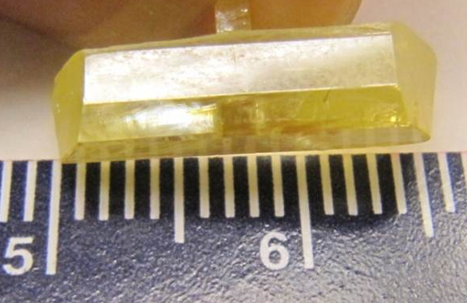
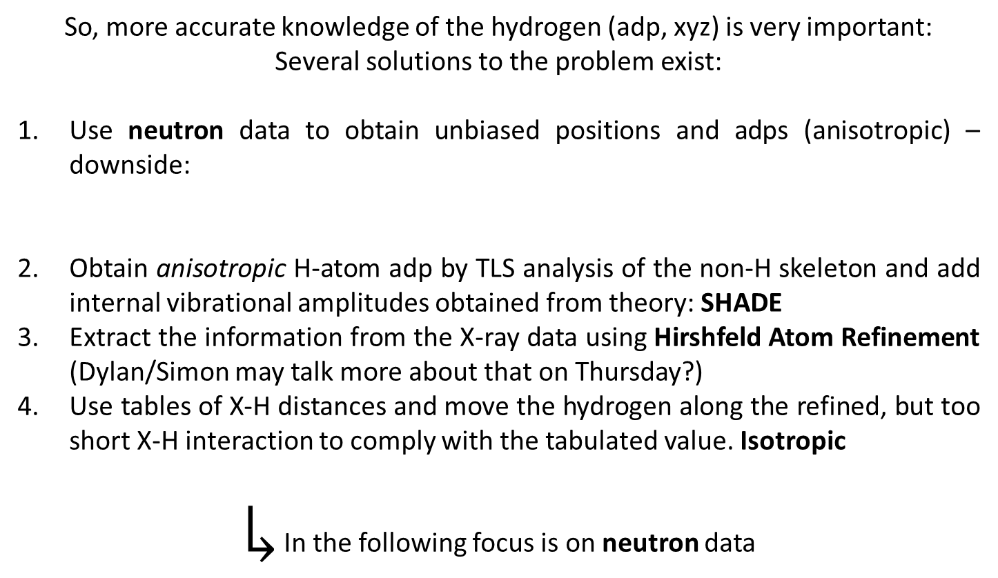
Hydrogen and X-rays
So, more accurate knowledge of the hydrogen (adp, xyz) is very important:
Several solutions to the problem exist:
Use neutron data to obtain unbiased positions and adps (anisotropic) – downside:
Obtain anisotropic H-atom adp by TLS analysis of the non-H skeleton and add internal vibrational amplitudes obtained from theory: SHADE
Extract the information from the X-ray data using Hirshfeld Atom Refinement (Dylan/Simon may talk more about that on Thursday?)
Use tables of X-H distances and move the hydrogen along the refined, but too short X-H interaction to comply with the tabulated value. Isotropic
$↳$ In the following focus is on neutron data

Slide 12
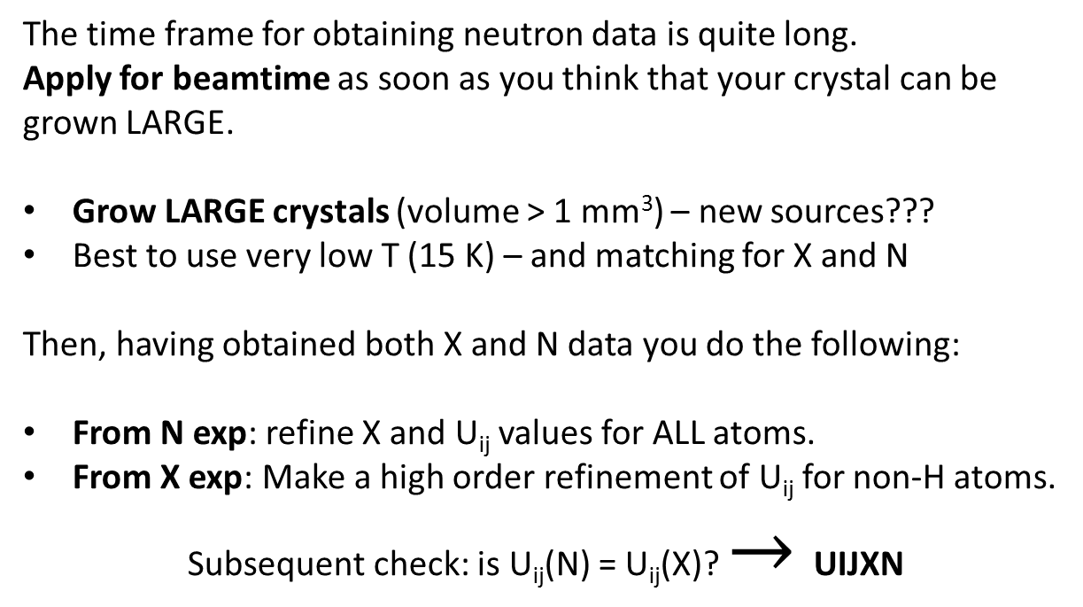
How to combine X and N data?
The time frame for obtaining neutron data is quite long.
Apply for beamtime as soon as you think that your crystal can be grown LARGE.
Grow LARGE crystals (volume > 1 mm³) – new sources???
Best to use very low T (15 K) – and matching for X and N
Then, having obtained both X and N data you do the following:
From N exp: refine X and U_{ij} values for ALL atoms.
From X exp: Make a high order refinement of U_{ij} for non-H atoms.
Subsequent check: is U_{ij}(N) = U_{ij}(X)? $→$UIJXN

Slide 13
Scaling - UIJXN
Input: X and N ADPs for the non-H atoms.
Output: <ΔU>; <U_{ii},X/U_{ii},N>; <ΔU²>^{½}
From these values, it is decided if the ADPs need to be scaled.
One possible scaling scheme could be:
U_{ij}(X) = k*U_{ij}(N) + ΔU_{ij}
Reasons for scaling?
Apply this scaling to the H atom U_{ij}(N) and use the new values in the refinement – you are now ready to start a “normal” XD refinement.

Slide 14
Moving on
In the subsequent charge density refinement, the positions and thermal parameters are kept fixed.
The number of multipoles refined for the H atoms involved in HBs (and others too) may now be increased to include all dipoles and quadropoles.

Slide 15
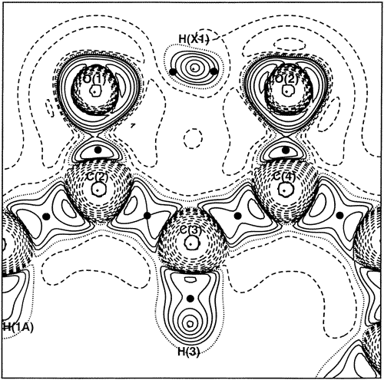
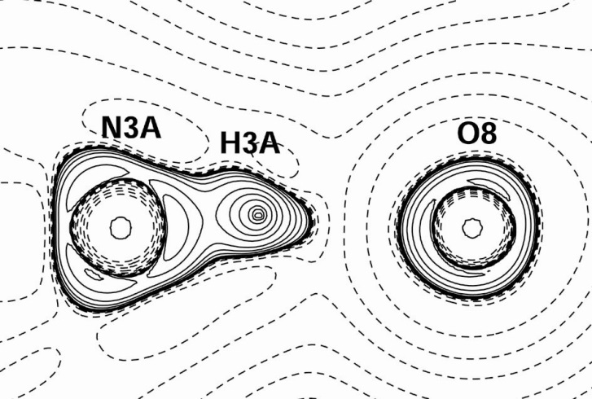
HB characterisation
Module XDPROP can be used to calculate the Laplacian distribution. This may be used to study the nature of the chemical bonding in the hydrogen bond.
Here are two examples from the tutorial:
Covalent or ionic?
Covalent
Electrostatic?

Slide 16

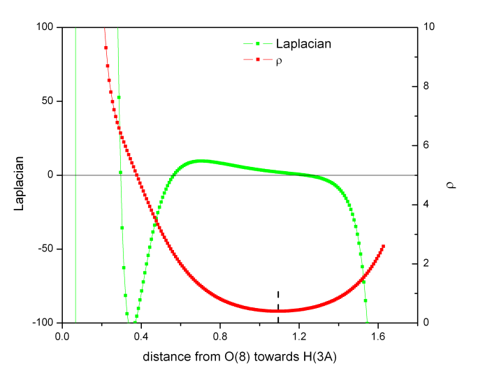
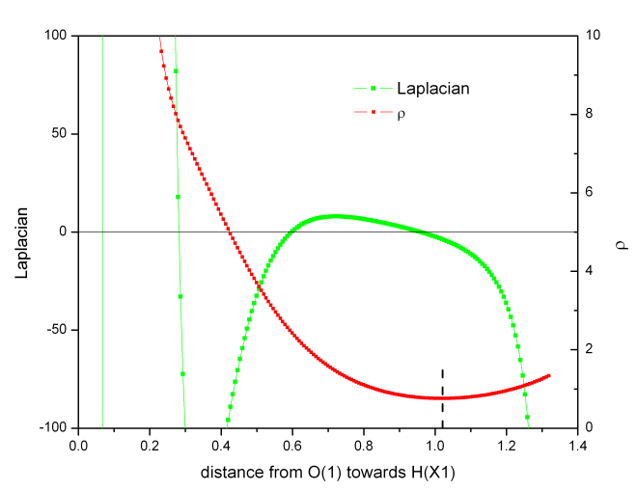
HB characterisation
The density and Laplacian along the O…H bond is also of interest:
bcp
bcp

Slide 17
Bond energies?
The bond dissociation energy of a HB has been empirically correlated with the topological properties at the HB bcp, using some approximations:
Based on results from neutron diffraction studies and the local virial theorem, Espinosa proposed a formula to derive the dissociation energy of a HB:
Abramov, Yu. A. Acta Cryst. 1997, A53, 264; Espinosa, E. et al., Chem. Phys. Lett. 1998, 285, 170.

Slide 18
Bond energies?
The previous formulae can be used on the examples:
H_{bcp} = -0.61 hartree Å⁻³; E_{HB} = 42.3 kcal mol⁻¹.
H_{bcp} = -0.13 hartree Å⁻³; E_{HB} = 18.1 kcal mol⁻¹.

Slide 19
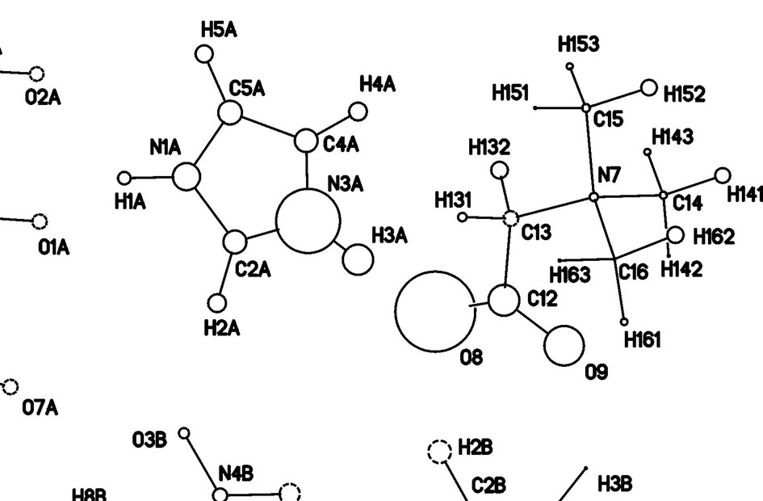
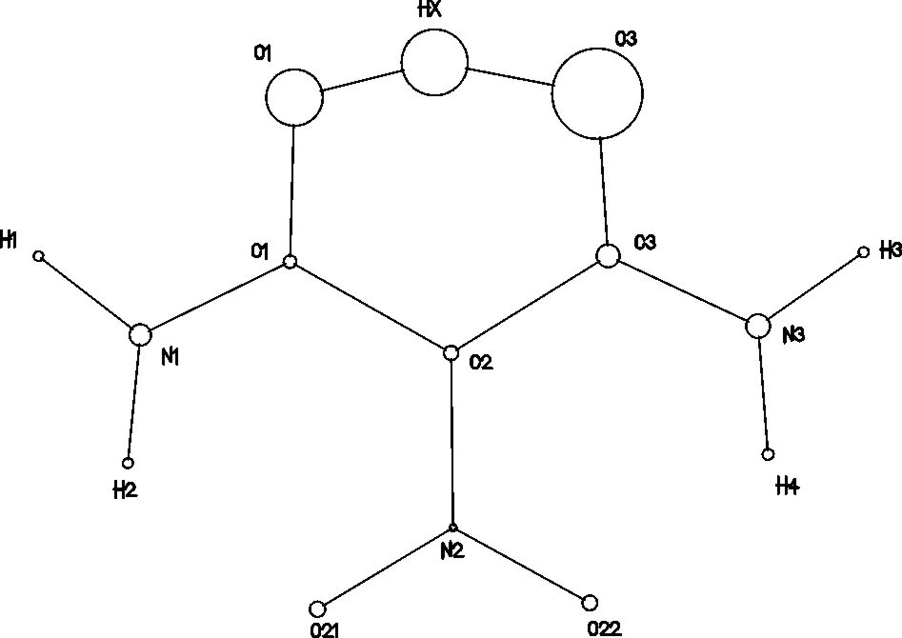
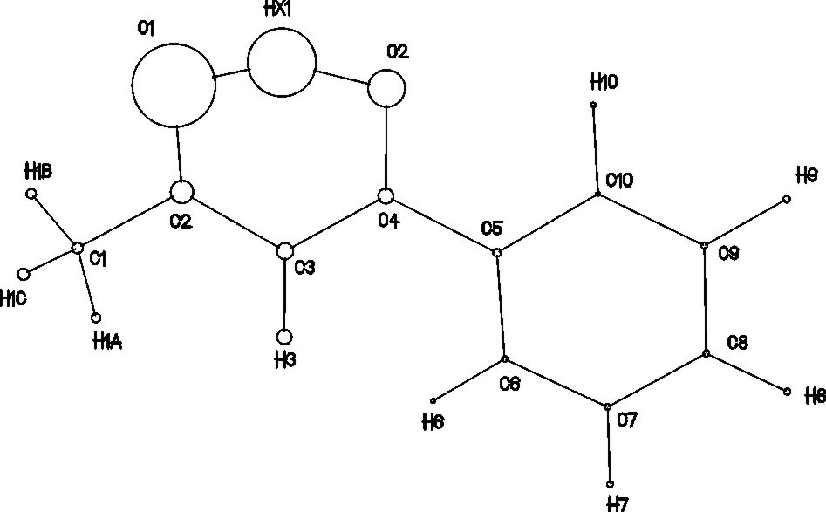
Source function
The source function has been described by Carlo Gatti.
Useful in analysis of HB’s as a tool to discriminate between types: What is important is the H contribution to the bcp:
30.5%
23.4%
4.9%
d(X---O) decreases from left to right
The trend is that the stronger HB’s are followed by an increase in the contribution from the H atom.

Slide 20
Tutorial #3
Tomorrow, there is a tutorial on how to complete an XD refinement on a system with a hydrogen bond.
You will be given working master and parameter files, that only needs slight modification.
Your task, if you choose to accept it, is to modify the files according to guidelines, and do refinements, mapping of residuals and Laplacian, as well as calculating properties.
Good luck with studying hydrogen atoms☺

